Slide 1
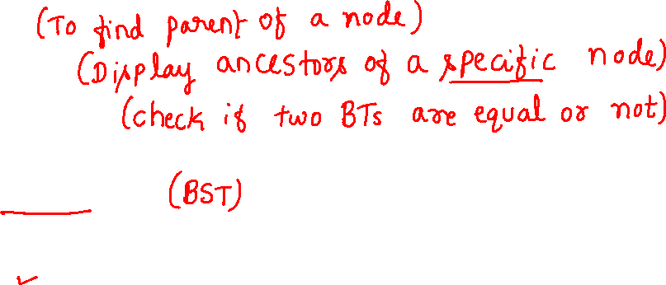
Binary Tree Operations:-
Parent
Ancestors
Equal or not
Binary Search Tree
Introduction
Insert
Search
Search2
Display
Delete

Slide 2
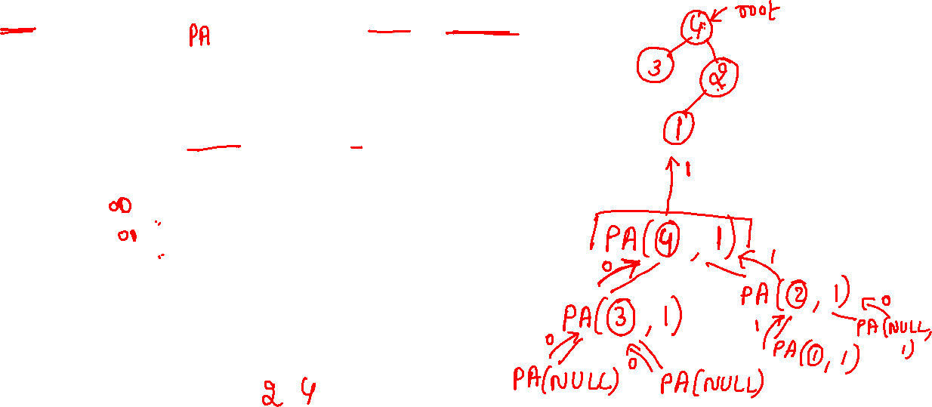
printAncestors
//If target is present in tree, then prints the ancestors and returns true, otherwise returns false.
int treenode::printAncestors(treenode *root, int target)
{
/* base cases */
if (root == NULL) return(0);
if (root->data == target) return(1);
/* If target is present in either left or right subtree of this node, then print this node */
if ( printAncestors(root->leftchild, target) ||
printAncestors(root->rightchild, target) )
{ cout << root->data << " "; return 1; }
return 0; /* Else return false */
}

Slide 3
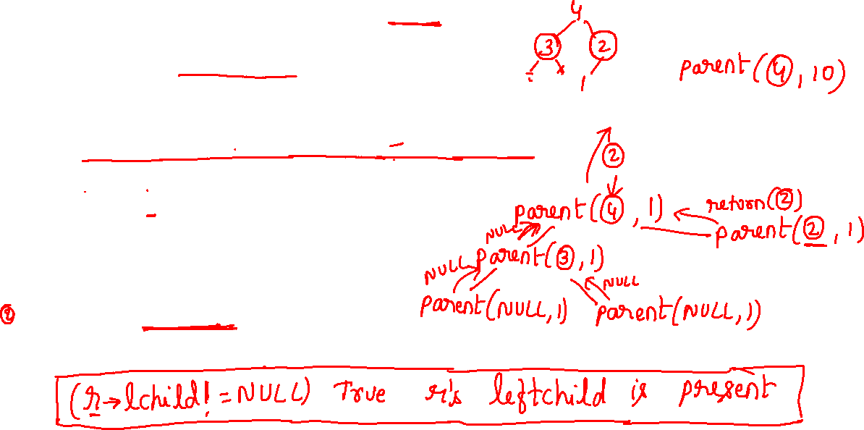
treenode* treenode::parent(treenode *r, int ele)
{
if(r==NULL||r->data==ele)
return(NULL);
If((r->leftchild!=NULL && r->leftchild->data==ele) || //ele is in leftchild of r
(r->rightchild!=NULL && r->rightchild->data==ele)) //ele is in rightchild of r
return(r);
treenode *res=parent(r->leftchild, ele);
if(res!=NULL) return(res);
res=parent(r->rightchild, ele);
return(res);
}
parent

Slide 4
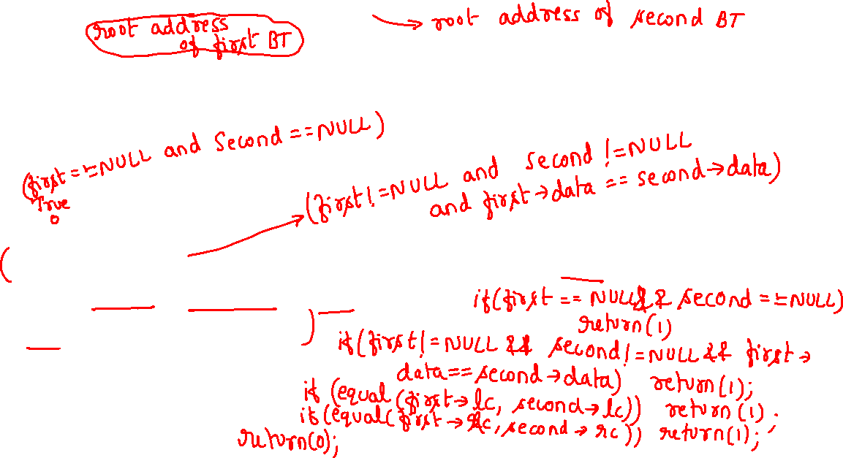
Checking if Two BT’s are containing same data
Equal or not
int equal(treenode *first, treenode *second)
{
// function returns False if the binary trees first and second are
// not equal, Otherwise it returns True
return
(
(!first&&!second) ||
(first && second && first->data==second->data) &&
equal(first->lc,second->lc) &&
equal(first->rc,second->rc)
);
}

Slide 5
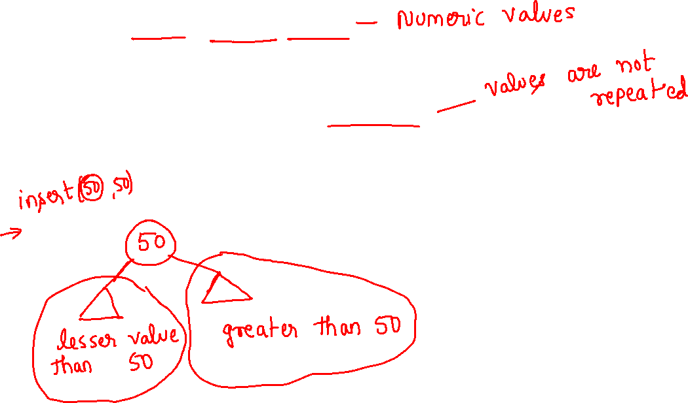
Binary Search Trees
Definition of binary search tree:
Every element has a unique key
The keys in a nonempty left subtree (right subtree) are smaller (larger) than the key in the root of subtree
The left and right subtrees are also binary search trees

Slide 6
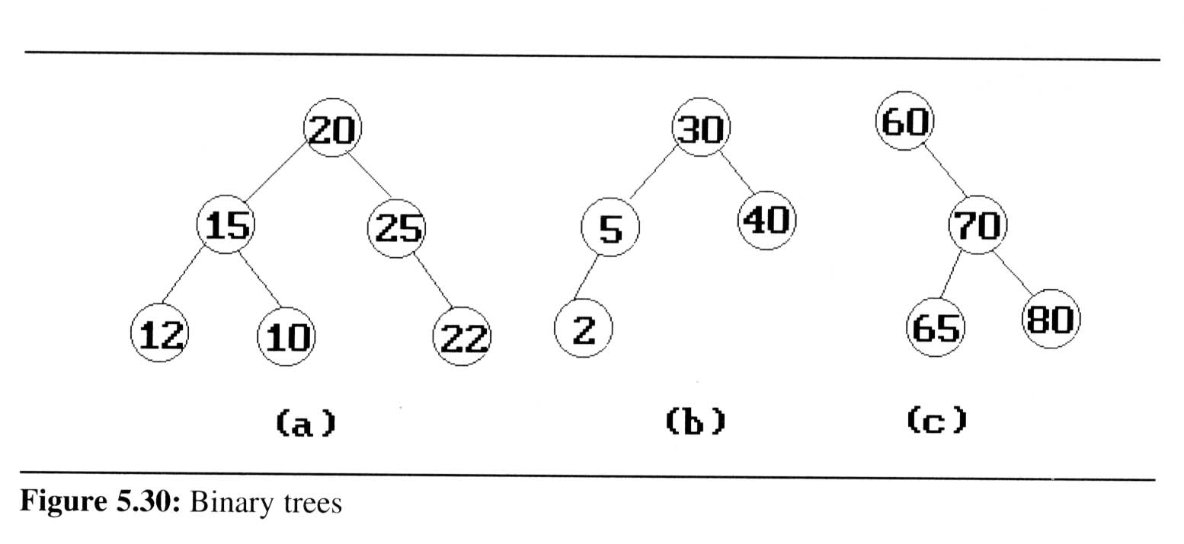

Binary Search Trees
Example: (b) and (c) are binary search trees
medium
smaller
larger

Slide 7
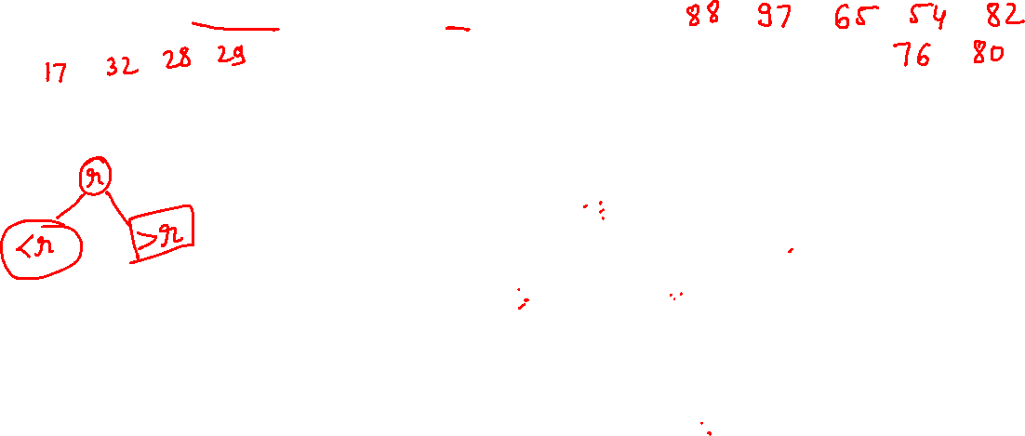
Binary Search Trees
Search:
Search(25)
Search(76)
44
17
88
32
65
97
28
54
82
29
76
80

Slide 8
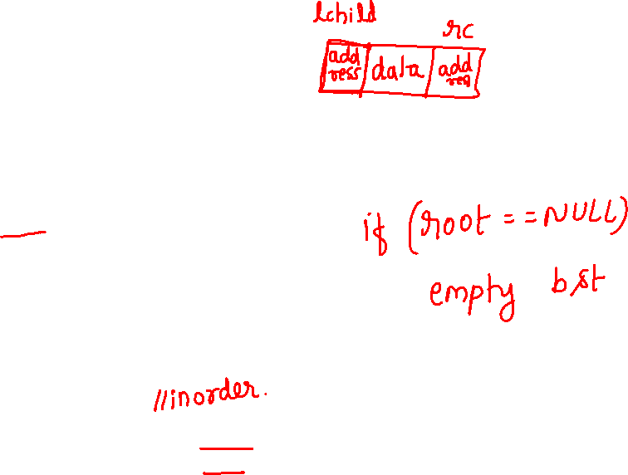
binary search tree class
class bst
{
bst *lchild;
int data;
bst *rchild;
public:
bst(int ele=0)
{
lchild=NULL;
rchild=NULL;
data=ele;
}
void insert(int);
void display(bst *root);
void search(int); //Iterative search
bst* search2(bst*, int); //Recursive search
void del(int);
};
bst *root=NULL;

Slide 9
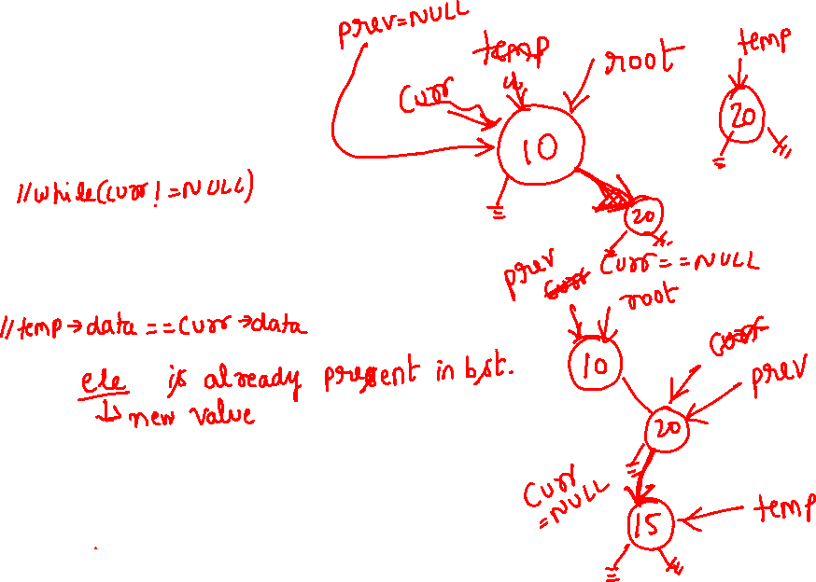
Insert into binary search tree
void bst::insert(int ele)
{ bst *temp=new bst(ele);
if(root==NULL){root=temp;return;}
else
{ bst *curr=root,*prev=NULL;
while(curr)
{
prev=curr;
if(temp->data<curr->data) curr=curr->lchild;
else if(temp->data>curr->data) curr=curr->rchild;
else
{ cout<<"Insertion is not possible";
return;
}
}
if(temp->data>prev->data)
prev->rchild=temp;
else if(temp->data<prev->data)
prev->lchild=temp;
}
return;
}

Slide 10

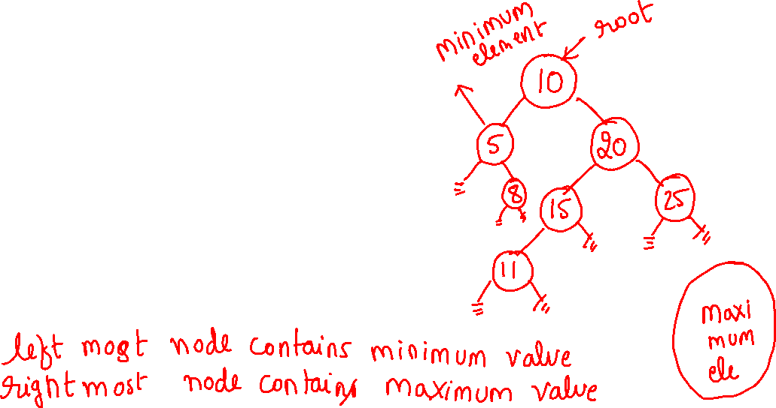
binary search tree: Display
void bst::display(bst *ptr)
{
if(ptr){
display(ptr->lchild);
cout<<" "<<ptr->data;
display(ptr->rchild);
}
}

Slide 11
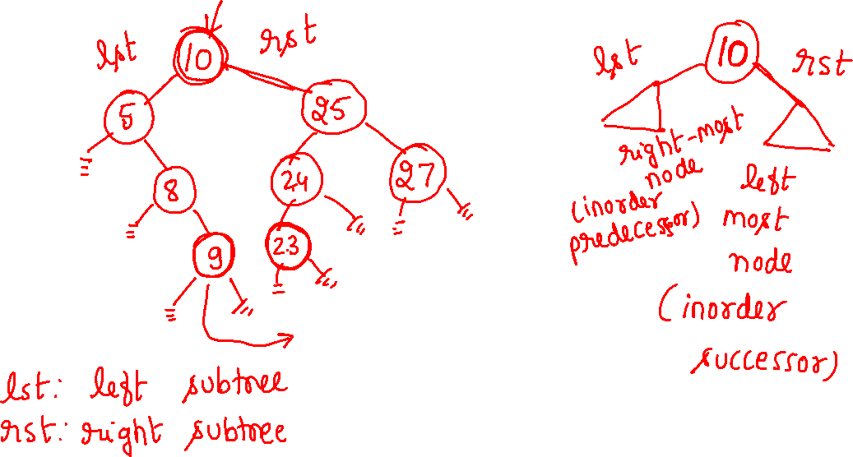

Slide 12
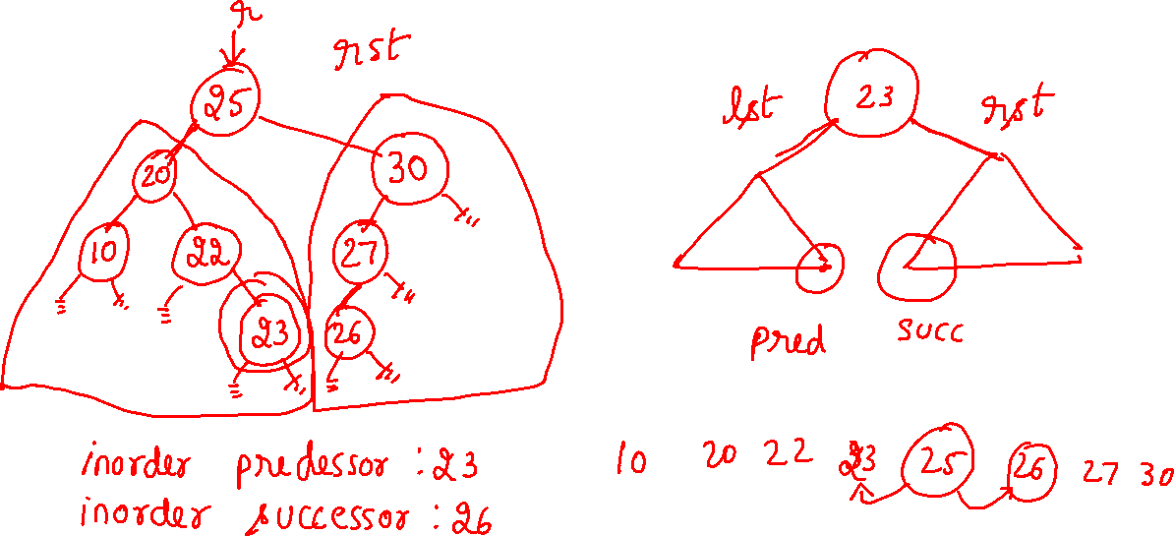

Slide 13
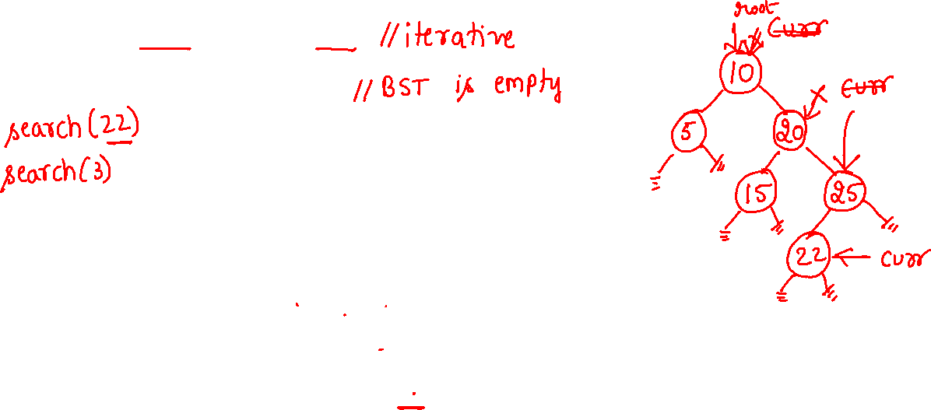
void bst::search(int ele)
{
if(root==NULL)
{ cout<<"tree is empty"; return; }
bst *curr=root;
while(curr!=NULL) //while(curr)
{
if(curr->data==ele)
{ cout<<"Element found"; return; }
else if(curr->data>ele) curr=curr->lchild;
else curr=curr->rchild; //curr->data<ele
}
cout<<"Element not found";
}

Slide 14
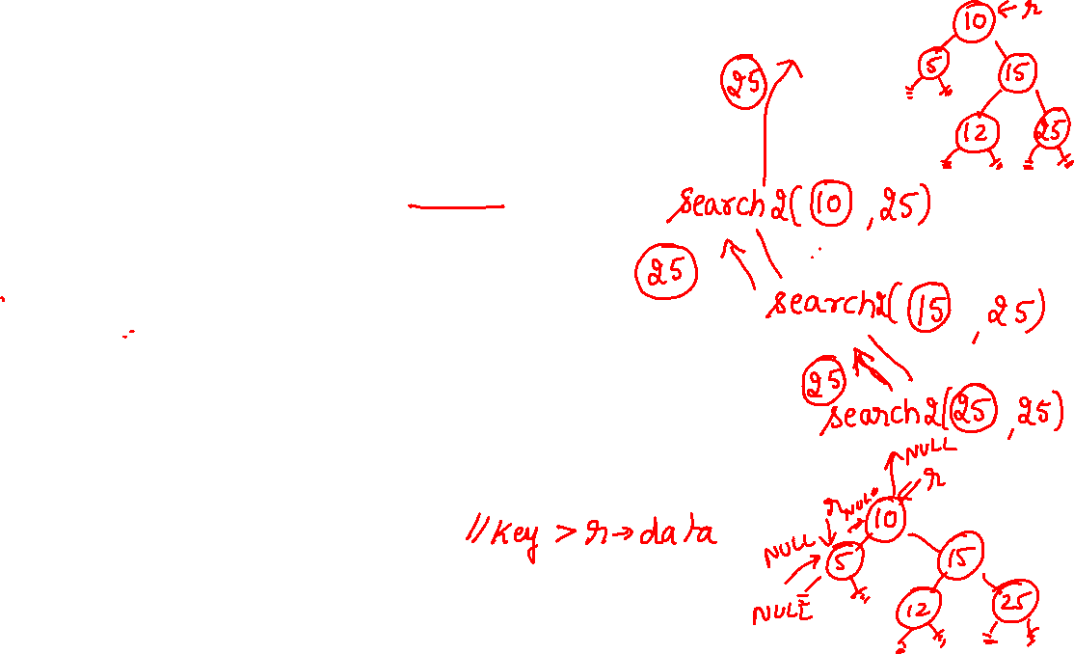
bst* bst::search2(bst *r,int key)
{
// return the node address of key element if key is found
// if key not found return NULL
if(!r) //if(r==NULL)
return NULL;
if(key==r->data) return r;
if(key<r->data) return(search2(r->lchild, key));
return(search2(r->rchild, key));
}

Slide 15
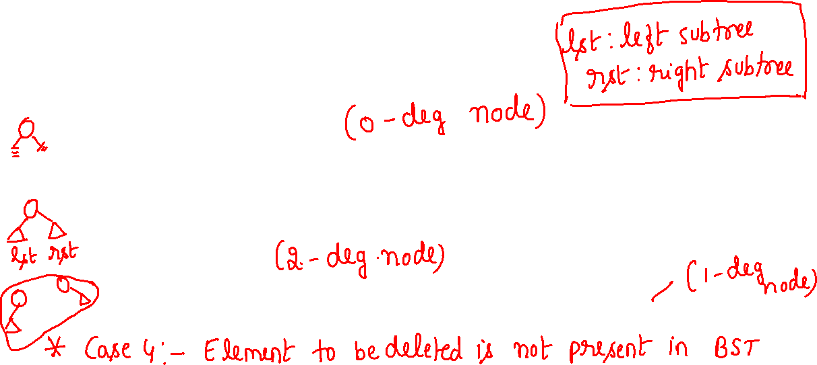
Deletion from a binary search tree
Three cases should be considered
Case 1. leaf → delete
Case 2. two children → replace the deleted element with either the smallest element in the right subtree or the largest element in the left subtree
Case 3. one child → delete and change the pointer to this child

Slide 16
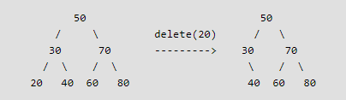

1) Node to be deleted is leaf: Simply remove from the tree.

Slide 17
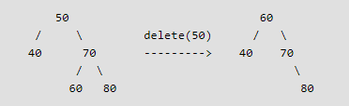

2)Node to be deleted has two children: Find inorder successor of the node. Copy contents of the inorder successor to the node and delete the inorder successor. Note that inorder predecessor can also be used.

Slide 18
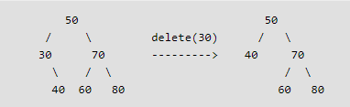

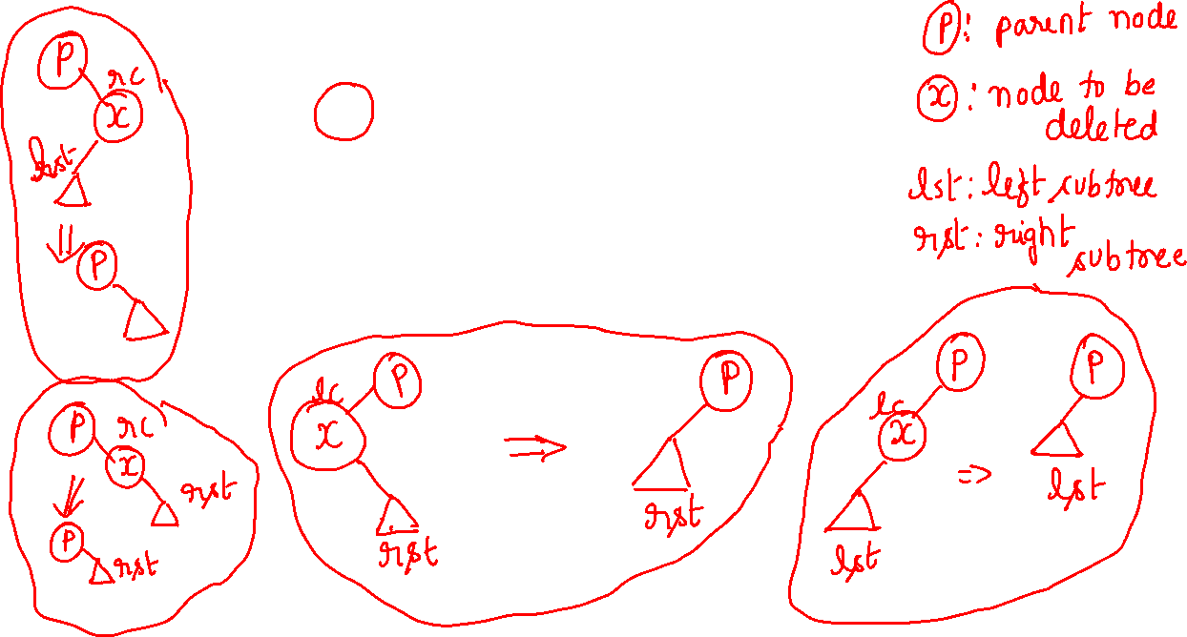
3) Node to be deleted has only one child: Copy the child to the node and delete the child

Slide 19
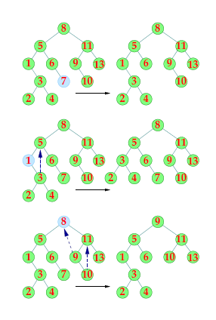
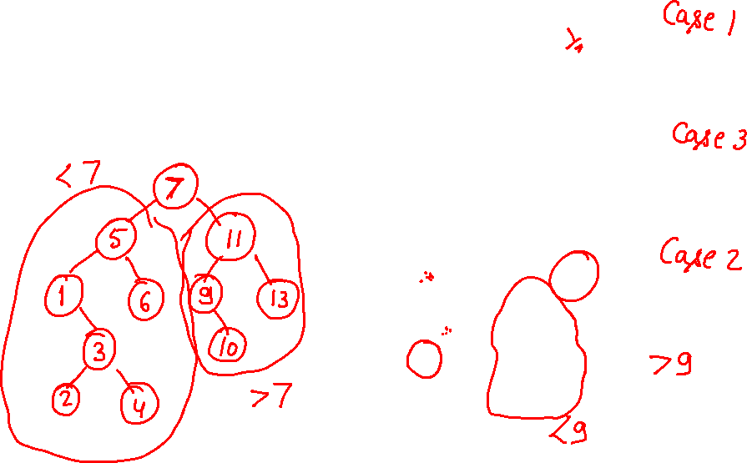

Slide 20
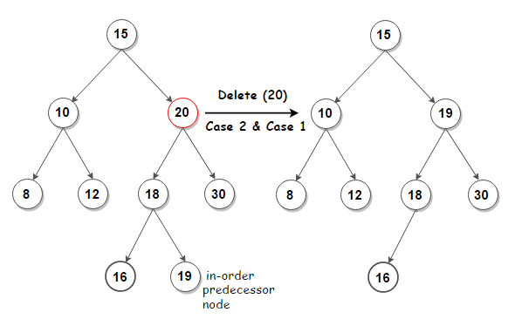
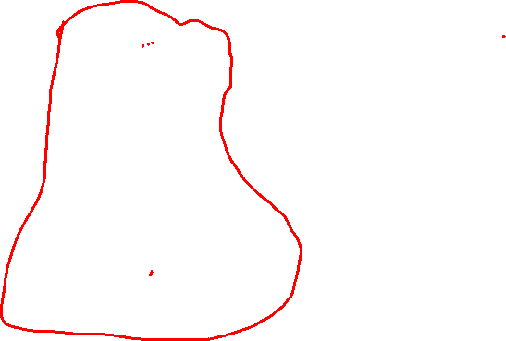
This slide shows an example for “Note that inorder predecessor can also be used.” mentioned in slide number 7
Delete(20) function call will do the following:
Case 2 will run first. According to case 2 the node to be deleted will get replaced by it’s inorder predecessor which is 19 (right-most node on the left subtree of 20)
Case 1 (As 19 is leaf node) will run next to delete node 19
According to case 1, 19’s parent 18->rchild must be made NULL.

Slide 21
// Helper function to find minimum value node in subtree rooted at curr
bst* minimumKey(bst* curr)
{
while(curr->lchild != NULL) curr = curr->lchild;
return curr;
}

Slide 22
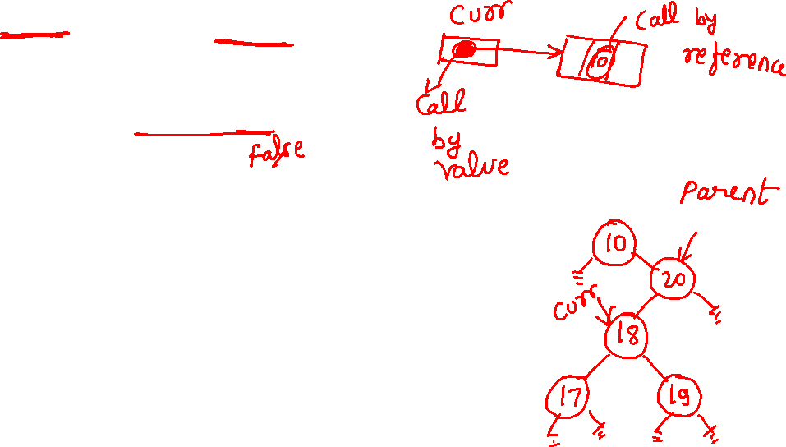
// Iterative function to search in subtree rooted at curr & set its parent
// Note that curr & parent are passed by reference
void searchKey(bst* &curr, int key, bst* &parent)
{
// traverse the tree and search for the key
while (curr != NULL&& curr->data != key)
{
// update parent node as current node
parent = curr;
// if given key is less than the current node, go to lchild subtree
// else go to rchild subtree
if (key < curr->data) curr = curr->lchild;
else curr = curr->rchild;
}
}

Slide 23
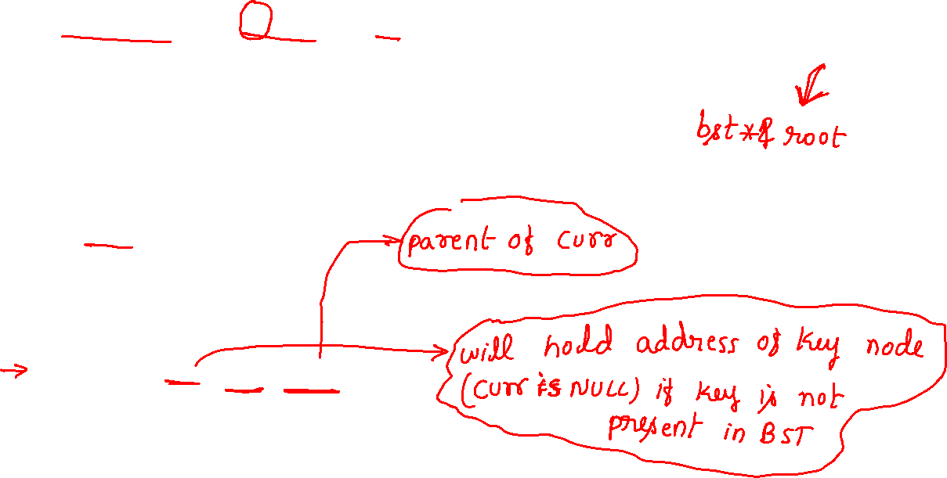
// Function to delete node from a BST
void deleteNode(bst*& root, int key) //Key is the node to be deleted
{
// pointer to store parent node of current node
bst* parent = NULL;
// start with root node
bst* curr = root;
// search key in BST and set its parent pointer
// curr holds the value key
searchKey(curr, key, parent);
// return if key is not found in the tree
if (curr == NULL) return;

Slide 24
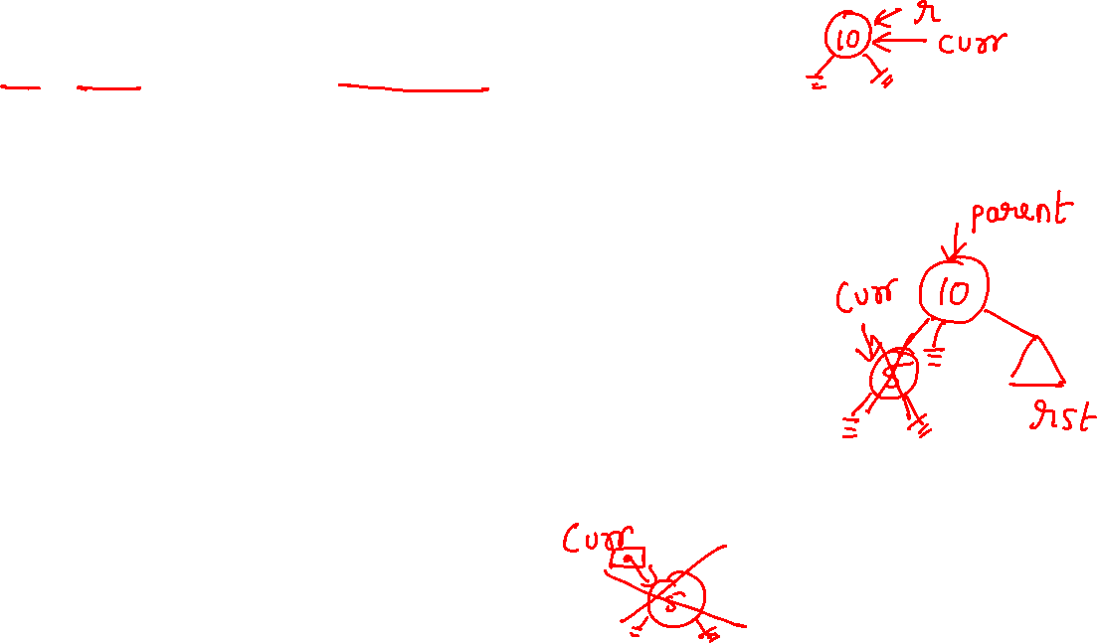
// Case 1: node to be deleted has no children i.e. it is a leaf node
if (curr->lchild ==NULL && curr->rchild ==NULL)
{
// if node to be deleted is not a root node, then set its parent lchild/rchild child to null
if (curr != root)
{
if (parent->lchild == curr) parent->lchild = NULL;
else parent->rchild =NULL;
}
// if tree has only root node, delete it and set root to null
else //if(curr==root)
root = NULL;
// deallocate the memory
delete(curr);
}

Slide 25
// Case 2: node to be deleted has two children
else if (curr->lchild && curr->rchild) //curr->lchild !=NULL &&curr->rchild!=NULL
{
// find its in-order successor node
bst* successor = minimumKey(curr->rchild);
// store successor value
int val = successor->data;
// recursively delete the successor. Note that the successor
// will have at-most one child
deleteNode(root, successor->data);
// Copy the value of successor to current node
curr->data = val;
}

Slide 26
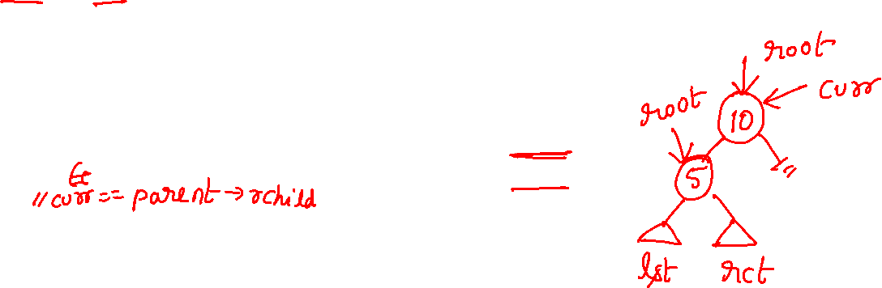
// Case 3: node to be deleted has only one child
else
{ bst* child = (curr->lchild)? curr->lchild: curr->rchild; // find child node
// if node to be deleted is not a root node, then set its parent to its child
if (curr != root)
{
if (curr == parent->lchild) parent->lchild = child;
else parent->rchild = child;
}
// if node to be deleted is root node, then set the root to child
else //curr==root
root = child;
delete(curr); // deallocate the memory
}
}

